Slide 1
PL/SQL - Subprogram
Unit - 5 (Cont…)

Slide 2
Subprogram
A subprogram is a program unit/module that performs a particular task.
These subprograms are combined to form larger programs. This is basically called the 'Modular design’.
A subprogram can be invoked by another subprogram or program which is called the calling program
At the schema level, subprogram is a standalone subprogram. It is created with the CREATE PROCEDURE or the CREATE FUNCTION statement. It is stored in the database and can be deleted with the DROP PROCEDURE or DROP FUNCTION statement.
PL/SQL subprograms are named PL/SQL blocks that can be invoked with a set of parameters. PL/SQL provides two kinds of subprograms −
Functions − These subprograms return a single value; mainly used to compute and return a value.
Procedures − These subprograms do not return a value directly; mainly used to perform an action.

Slide 3
Procedure
Procedures and Functions are the subprograms which can be created and saved in the database as database objects. They can be called or referred inside the other blocks also.
A stored procedure in PL/SQL is a series of declarative SQL statements which can be stored in the database catalogue.
A procedure can be thought of as a function or a method.
They can be invoked through triggers, other procedures, or applications on Java, PHP etc.
All the statements of a block are passed to Oracle engine all at once which increases processing speed and decreases the traffic.

Slide 4
Advantages
They result in performance improvement of the application. If a procedure is being called frequently in an application in a single connection, then the compiled version of the procedure is delivered.
They reduce the traffic between the database and the application, since the lengthy statements are already fed into the database and need not be sent again and again via the application.
They add to code reusability, similar to how functions and methods work in other languages such as C/C++ and Java.

Slide 5
Limitations
Stored procedures can cause a lot of memory usage. The database administrator should decide an upper bound as to how many stored procedures are feasible for a particular application.
MySQL does not provide the functionality of debugging the stored procedures.

Slide 6
Parameter
The parameter is variable or placeholder of any valid PL/SQL datatype through which the PL/SQL subprogram exchange the values with the main code. This parameter allows to give input to the subprograms and to extract from these subprograms.
These parameters should be defined along with the subprograms at the time of creation.
These parameters are included n the calling statement of these subprograms to interact the values with the subprograms.
The datatype of the parameter in the subprogram and the calling statement should be same.
The size of the datatype should not mention at the time of parameter declaration, as the size is dynamic for this type.

Slide 7
Types of Parameters
IN Parameter:
This parameter is used for giving input to the subprograms.
It is a read-only variable inside the subprograms. Their values cannot be changed inside the subprogram.
In the calling statement, these parameters can be a variable or a literal value or an expression, for example, it could be the arithmetic expression like ‘5*8’ or ‘a/b’ where ‘a’ and ‘b’ are variables.
By default, the parameters are of IN type.

Slide 8
Types of Parameters
OUT Parameter:
This parameter is used for getting output from the subprograms.
It is a read-write variable inside the subprograms. Their values can be changed inside the subprograms.
In the calling statement, these parameters should always be a variable to hold the value from the current subprograms.

Slide 9
Types of Parameters
IN OUT Parameter:
This parameter is used for both giving input and for getting output from the subprograms.
It is a read-write variable inside the subprograms. Their values can be changed inside the subprograms.
In the calling statement, these parameters should always be a variable to hold the value from the subprograms.
These all parameter type should be mentioned at the time of creating the subprograms.

Slide 10
RETURN
RETURN is the keyword that instructs the compiler to switch the control from the subprogram to the calling statement.
In subprogram RETURN simply means that the control needs to exit from the subprogram. Once the controller finds RETURN keyword in the subprogram, the code after this will be skipped.
Normally, parent or main block will call the subprograms, and then the control will shift from those parent block to the called subprograms.
RETURN in the subprogram will return the control back to their parent block. In the case of functions RETURN statement also returns the value.
The datatype of this value is always mentioned at the time of function declaration. The datatype can be of any valid PL/SQL data type.

Slide 11
Characteristics of Procedure subprogram unit in PL/SQL
Procedures are standalone blocks of a program that can be stored in the database.
Call to these PLSQL procedures can be made by referring to their name, to execute the PL/SQL statements.
It is mainly used to execute a process in PL/SQL.
It can have nested blocks, or it can be defined and nested inside the other blocks or packages.
It contains declaration part (optional), execution part, exception handling part (optional).
The values can be passed into Oracle procedure or fetched from the procedure through parameters.
These parameters should be included in the calling statement.
A Procedure in SQL can RETURN the control to the calling block, but it cannot return any values through the RETURN statement.
Procedures cannot be called directly from SELECT statements. They can be called from another block or through EXEC keyword.

Slide 12
Syntax
CREATE OR REPLACE PROCEDURE
<procedure name>
(
<parameter IN/OUT <datatype>
..
.
)
[ IS | AS ]
<declaration part>
BEGIN
<execution part>
EXCEPTION
<exception handling part>
END;
CREATE PROCEDURE instructs the compiler to create new procedure in Oracle. Keyword ‘OR REPLACE’ instructs the compile to replace the existing procedure (if any) with the current one.
Procedure name should be unique.
Keyword ‘IS’ will be used, when the stored procedure in Oracle is nested into some other blocks. If the procedure is standalone then ‘AS’ will be used. Other than this coding standard, both have the same meaning.

Slide 13
create or replace procedure p1
(empid IN emp.empno%type, enm OUT emp.ename%type) is
Begin
Select ename into enm from emp where empno = empid;
Exception
when NO_DATA_FOUND then
DBMS_Output.Put_Line('No Emp...');
end;
/
TO USE...
(I) Write another block
declare
name varchar(25);
begin
p1(7900,name);
DBMS_output.put_line(name);
end;
/
(II) Without PLSQL block
SQL> variable nm varchar2(40);
SQL> execute p1(7900,:nm);
PL/SQL procedure successfully completed.
SQL> print nm;

Slide 14
Function
Functions is a standalone PL/SQL subprogram. Like PL/SQL procedure, functions have a unique name by which it can be referred. These are stored as PL/SQL database objects. Below are some of the characteristics of functions.
Functions are a standalone block that is mainly used for calculation purpose.
Function use RETURN keyword to return the value, and the datatype of this is defined at the time of creation.
A Function should either return a value or raise the exception, i.e. return is mandatory in functions.
Function with no DML statements can be directly called in SELECT query whereas the function with DML operation can only be called from other PL/SQL blocks.
It can have nested blocks, or it can be defined and nested inside the other blocks or packages.
It contains declaration part (optional), execution part, exception handling part (optional).
The values can be passed into the function or fetched from the procedure through the parameters.
These parameters should be included in the calling statement.
A PLSQL function can also return the value through OUT parameters other than using RETURN.
Since it will always return the value, in calling statement it always accompanies with assignment operator to populate the variables.

Slide 15
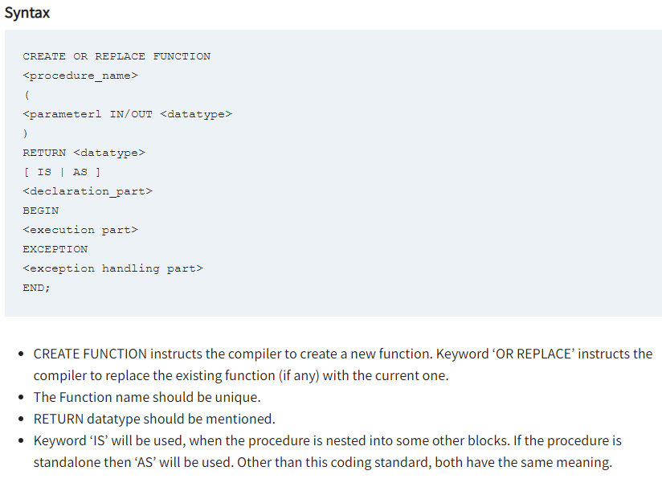

Slide 16
Example
create or replace function f1
(no IN number)
return number
as
nm varchar(25);
begin
select ename into nm from emp where empno = no;
return 1;
exception
when no_data_found then
return 0;
end;
/
declare
chk number(1);
begin
chk := f1(7988);
if chk = 0 then
dbms_output.Put_line('Employee does not exists...');
else
dbms_output.put_line('Employee exists...');
end if;
end;
/

